Slide 1

Approximate String Matching:
Bit-Parallel Approach
Midterm Presentation
Gang Liao, liao.gang@kaust.edu.sa
Fatima Zohra Smailiy, fatimazohra.smaili@kaust.edu.sa
Wentao Hu, wentao.hu@kaust.edu.sa
Guangming Zang, guangming.zang@kaust.edu.sa

Slide 2
Background
Approximate string matching is one of the main problems in classical algorithms, with applications to text searching, computational biology, pattern recognition, text processing, spell checking, spam filtering, etc.

Slide 3
Background
For the approximate string matching problem we look for a substring that is similar to pattern P in text T. The word similar here refers to a string that needs a minimum number of operations (insertion, deletion and substitution) to be converted to P. This minimum number of operations is what we refer to as the edit distance.

Slide 4
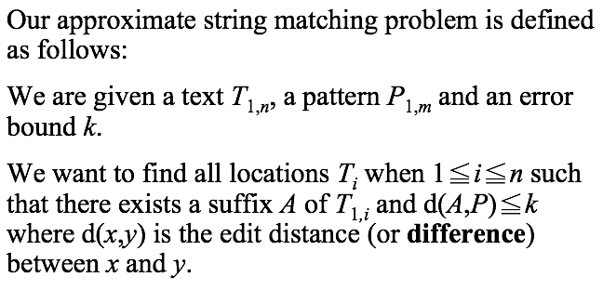
Background

Slide 5
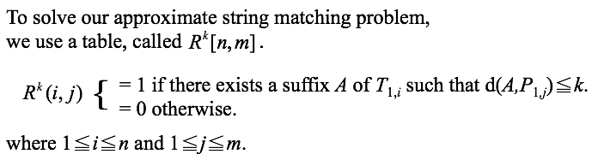
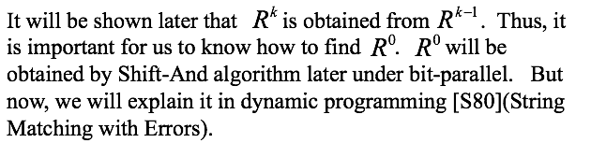
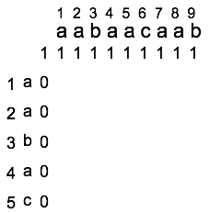

Slide 6
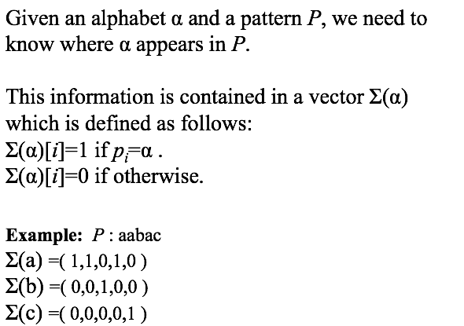

Slide 7
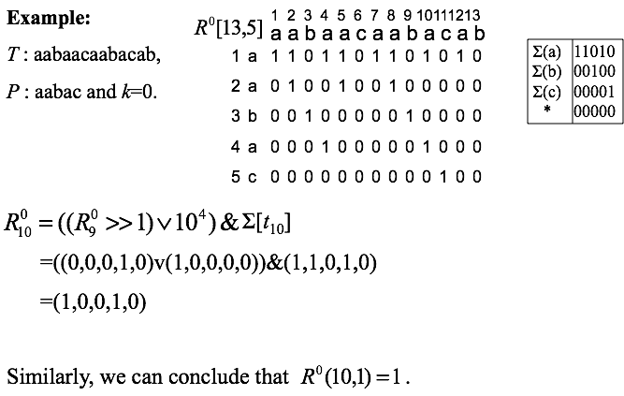

Slide 8
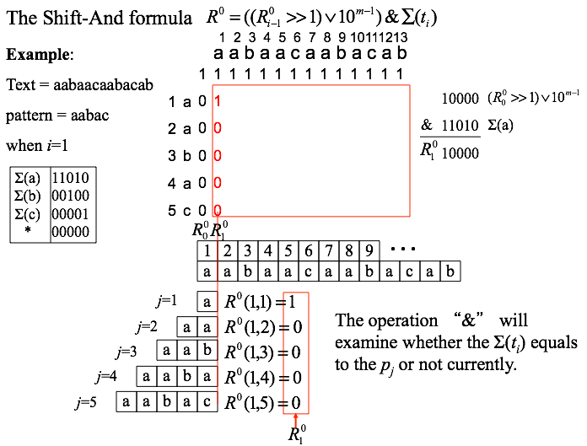

Slide 9
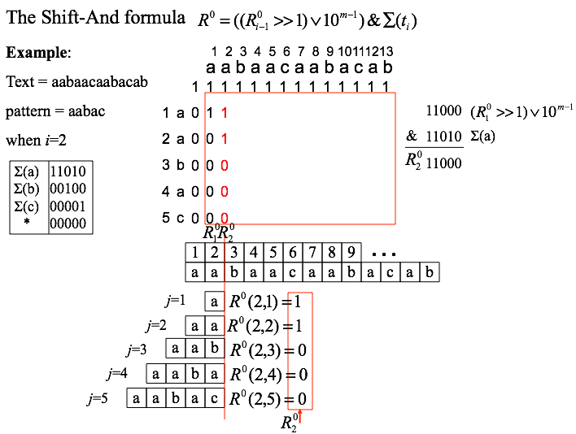

Slide 10
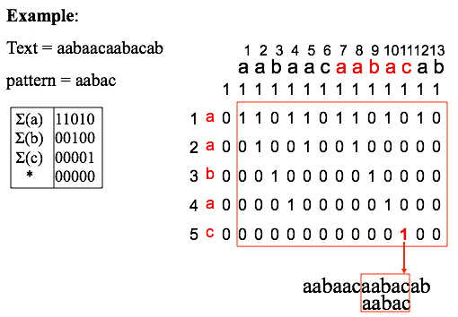

Slide 11
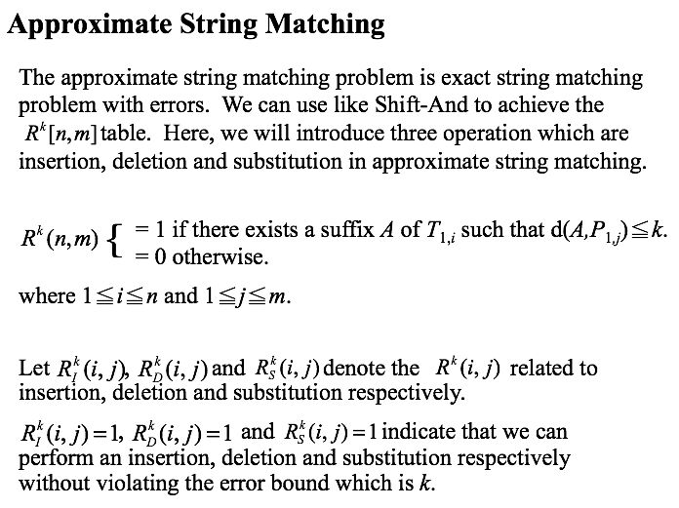

Slide 12
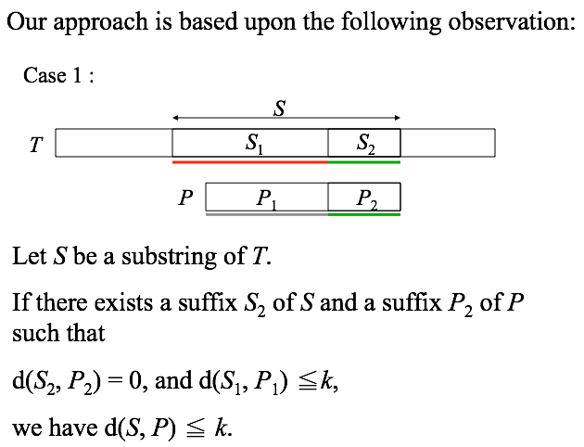

Slide 13
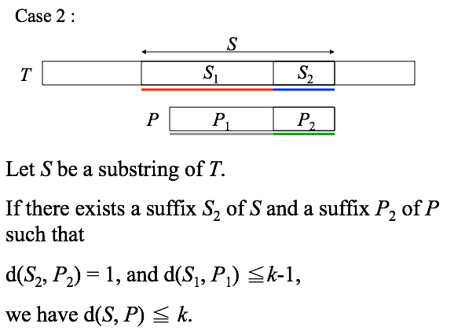

Slide 14

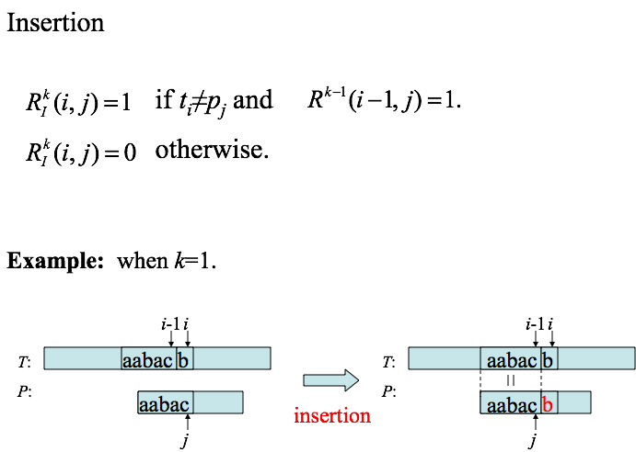

Slide 15
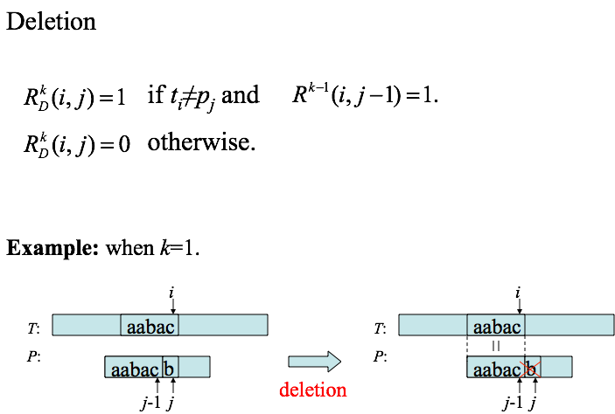


Slide 16
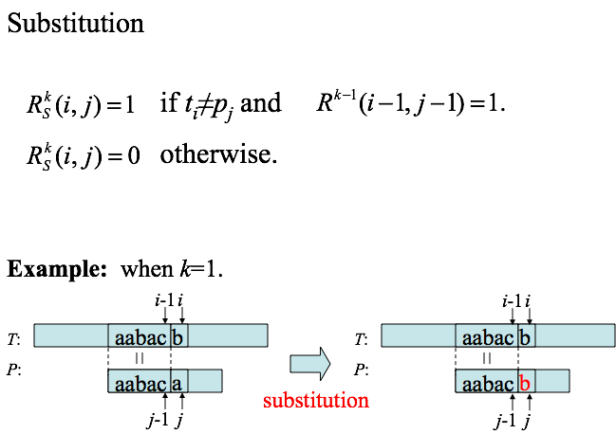


Slide 17
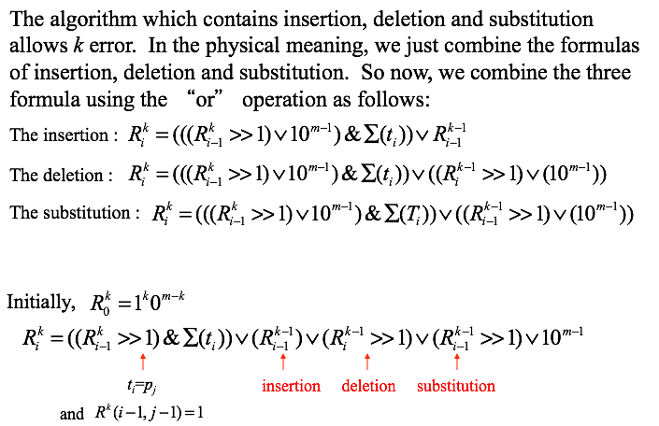

Slide 18
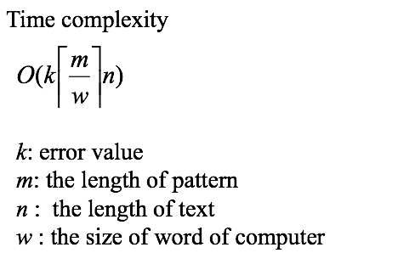
https://github.com/GangLiao/Approximate-String-Matching

Slide 19
The Second Algorithm
Our team member, Fatima
will present 2nd algorithm.

Slide 20

Thank You!

